Slide 1
Time Series Analysis
Jan 20, 2022
Gwangwoo Kim

Slide 2
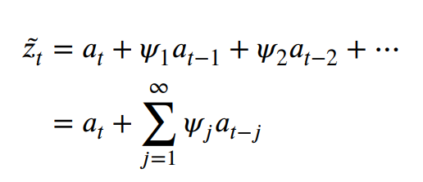
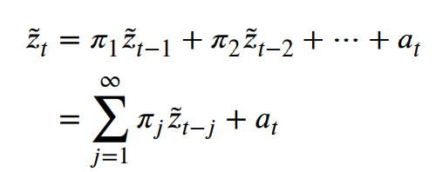
Review
Stationary process
General linear process

Slide 3

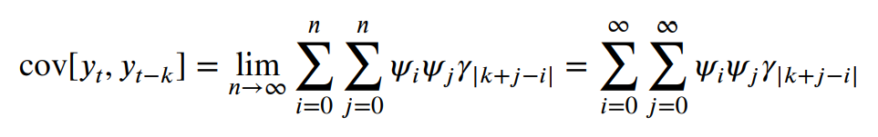
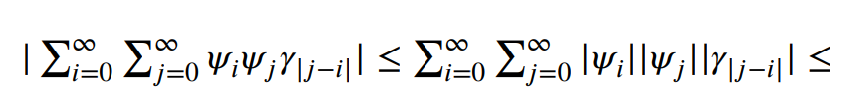

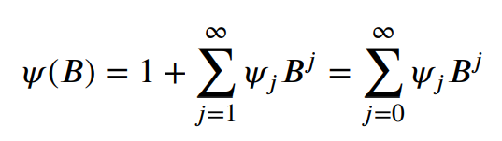
Review
Well-defined and stationary if
General linear processes
converges within the unit circle of B
Grenander and Rosenblatt, 1957

Slide 4



Review
Always true?
General linear processes
Alternative form of general linear processes
Consider . Whatever the value of theta, it defines a perfectly proper stationary process.
But alternative form may not be well-defined:
well-defined if abs(theta) < 1

Slide 5
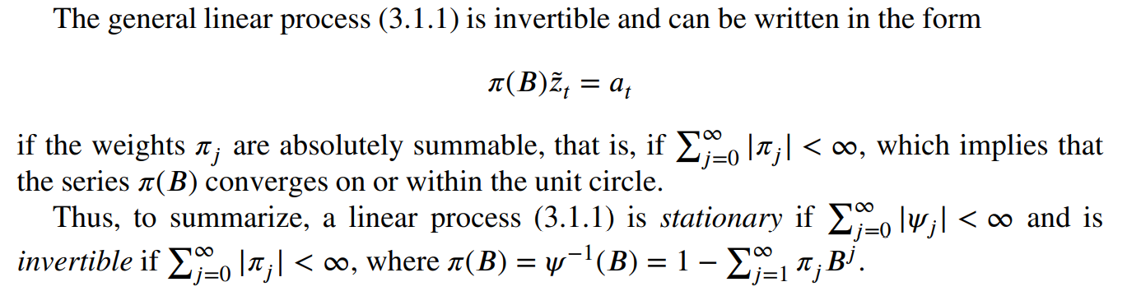
Review
Although invertibility follows from a general linear process, its definition is now independent of it.

Slide 6




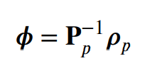
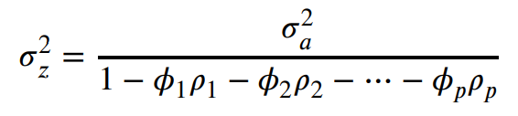



Autoregressive (AR)
Model:
Characteristic equation for stationarity:
ACFs:
Variance:
PACF:
or
Yule-Walker equation

Slide 7
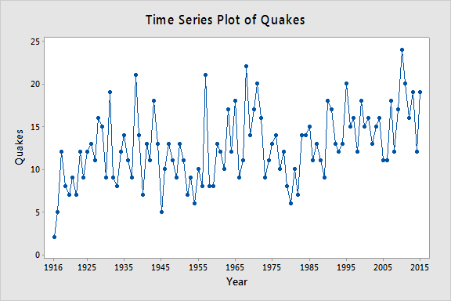
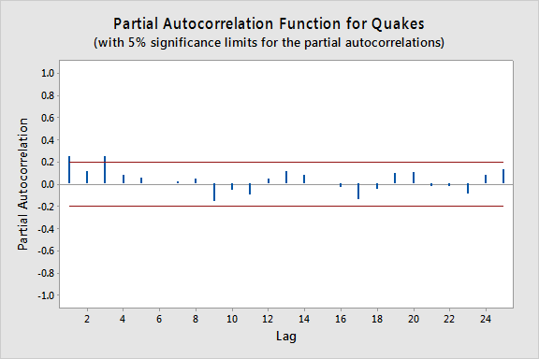
Real-life example

Slide 8


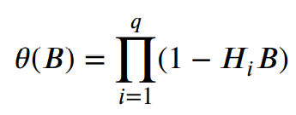
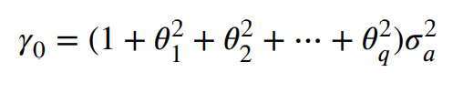
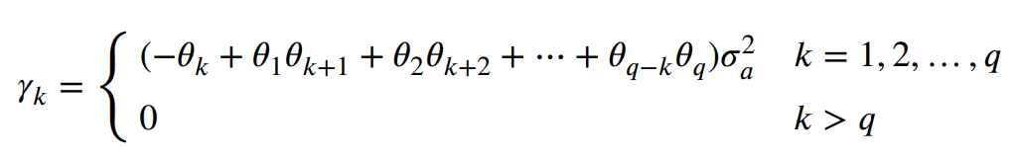
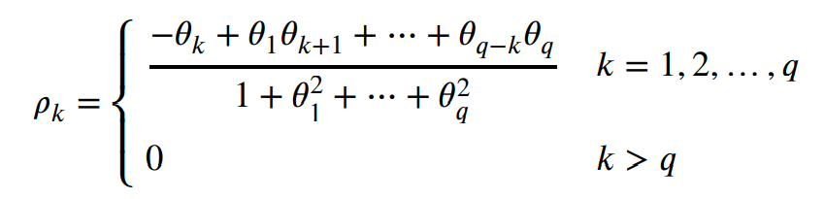
Moving Average (MA)
Model:
Characteristic equation for invertibility:
Variance:
ACFs:
or
<Remark>
We see that the autocorrelation function of an MA(𝑞) process is zero, beyond the order 𝑞 of the process.
The above rho equations are not linear. We will discuss this problem later. (Chap 6 or 7)

Slide 9
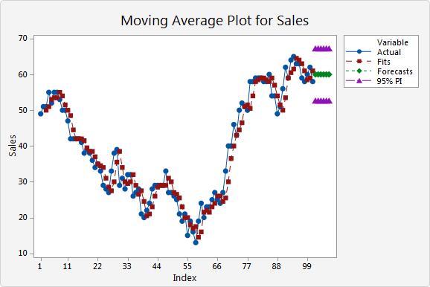
Real-life example

Slide 10
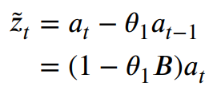

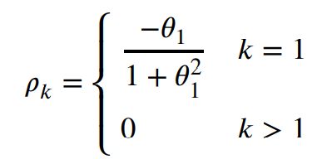

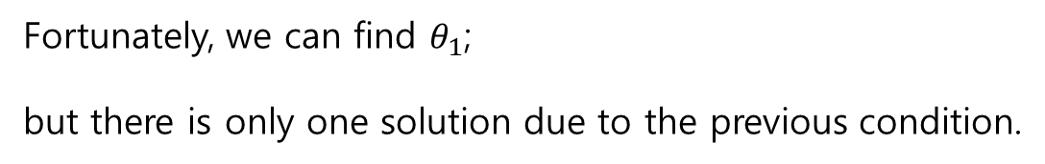
Example 1: MA(1)
Model:
For invertibility:
Variance:
ACF:
Fortunately, we can find $θ_{1}$;
but there is only one solution due to the previous condition.

Slide 11
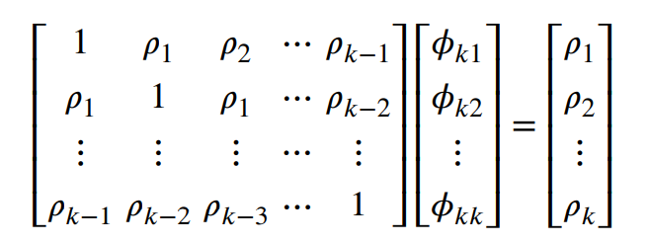
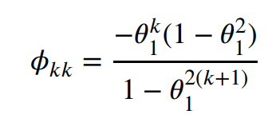
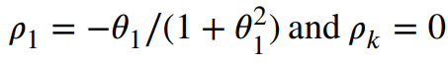

Example 1: MA(1)
PACF:
Yule-Walker equation
In particular,

Slide 12






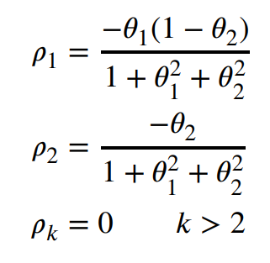
Example 2: MA(2)
Model:
For invertibility:
Variance:
ACF:

Slide 13
Duality
 | AR | MA
invertibility | O | X
stationarity | X | O
ACF | Exponentially damped | cutoff
PACF | cutoff | Exponentially damped

Slide 14



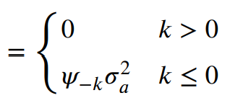
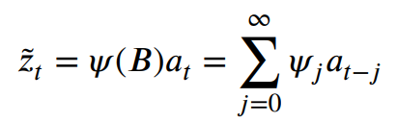

Autoregressive Moving Average (ARMA)
Model:
Characteristic equation for invertibility:
ACF:
In particular,
or
where
Note:

Slide 15
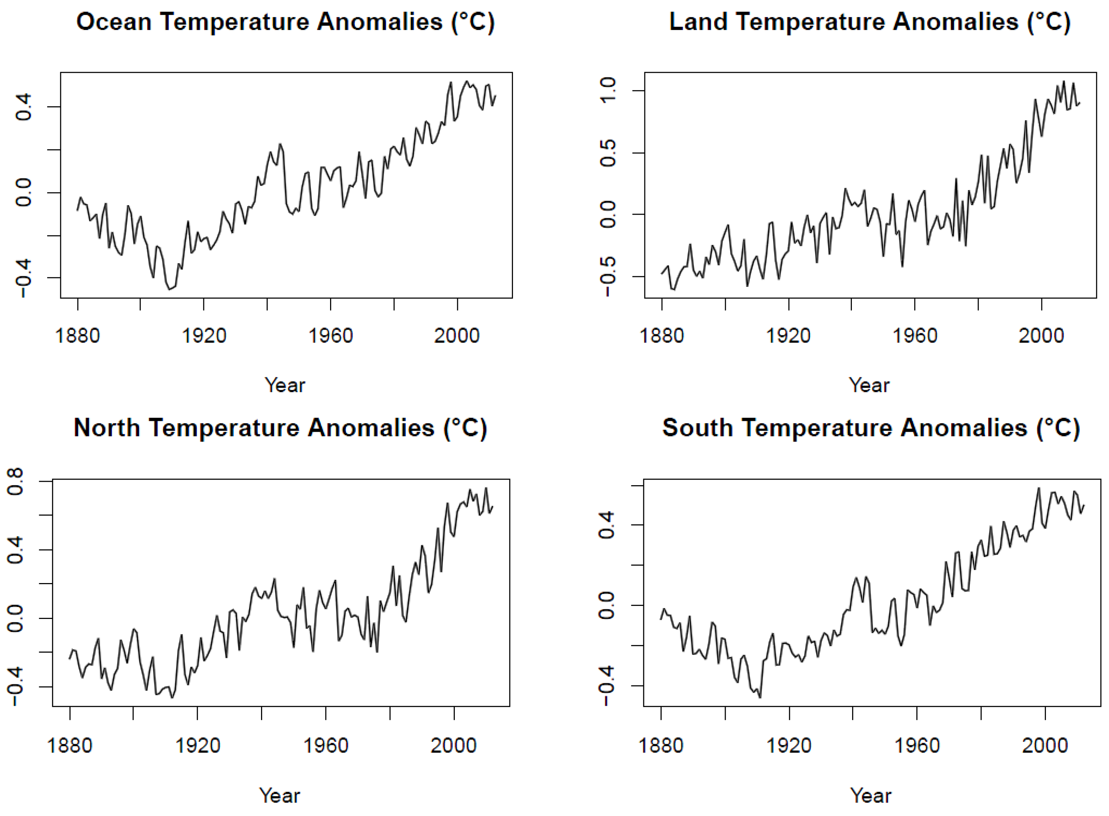
Real-life example

Slide 16


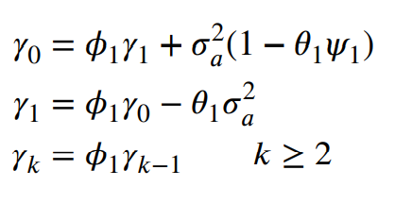
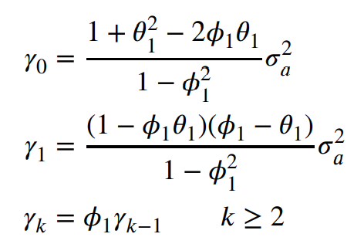
Example ARMA(1,1)
Model:
Admissible region:
ACF:
or
and
Solving equations

Slide 17
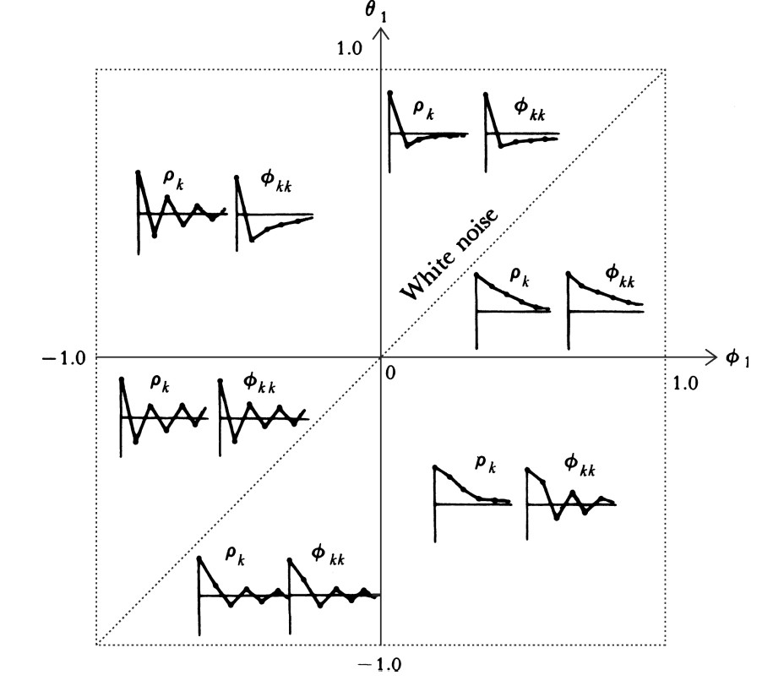
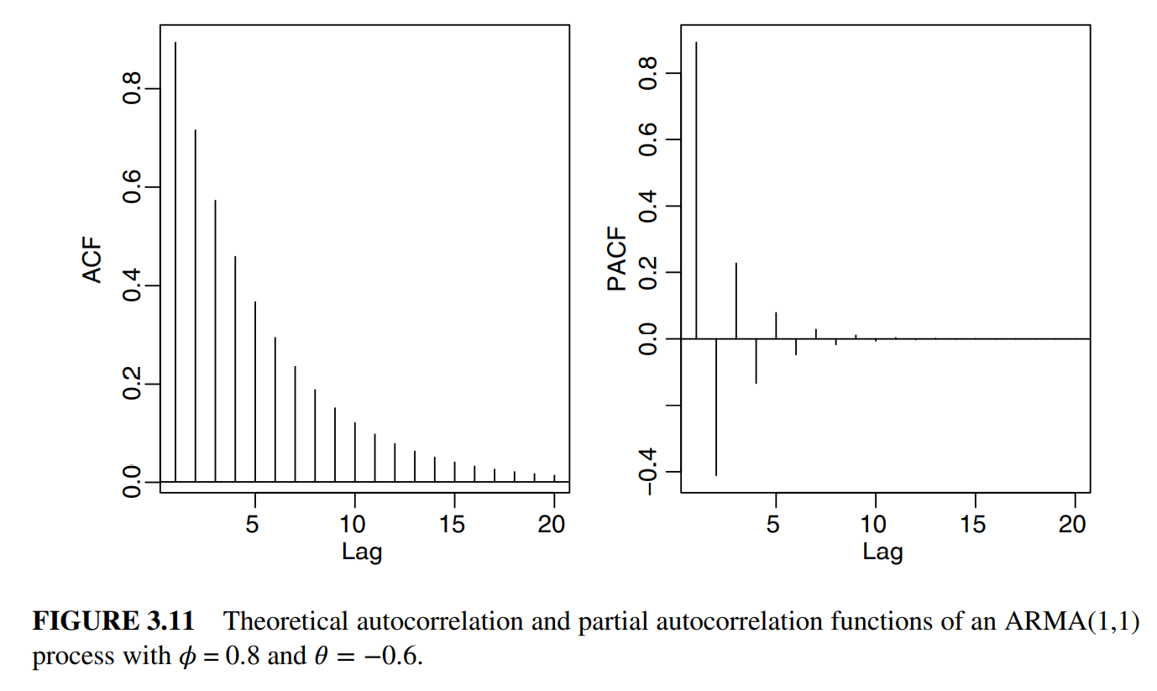
Example ARMA(1,1)

Slide 18
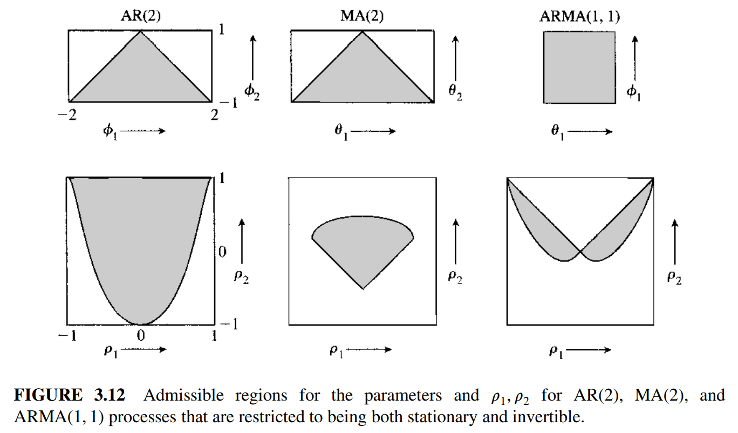
Summary

Slide 19
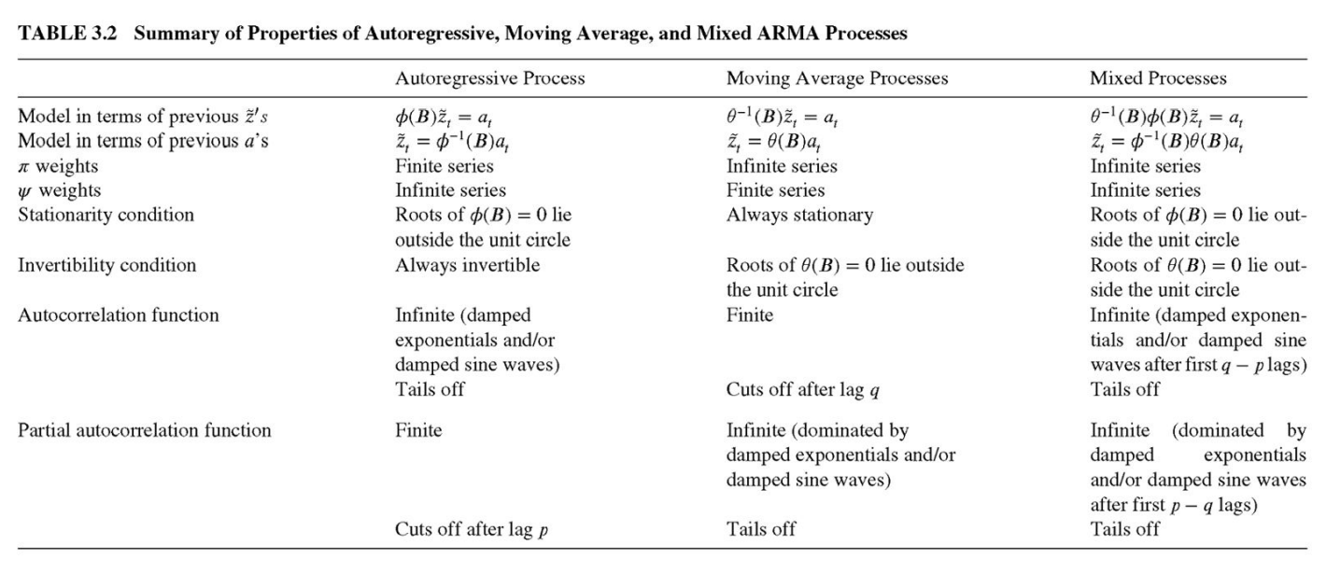
Summary

Slide 20
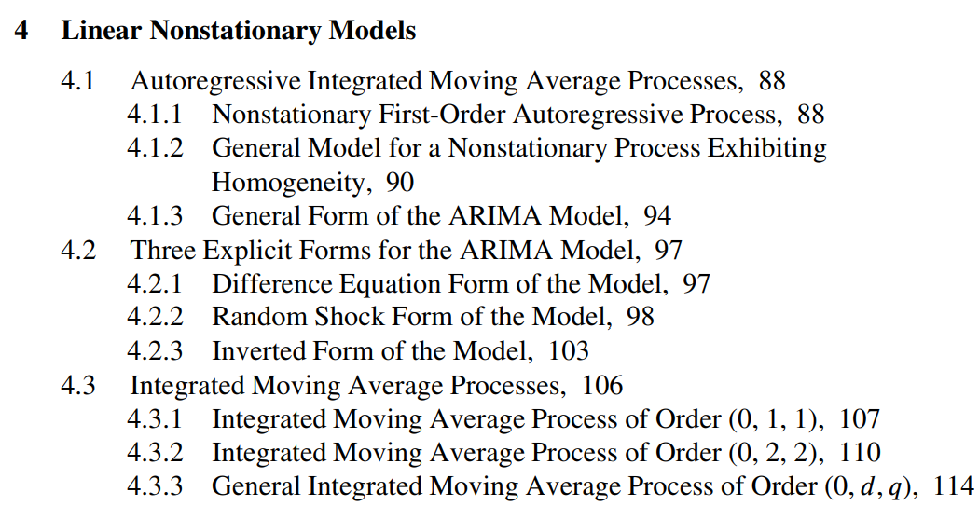
What’s next?

